Slide 1
Embedded Software for Networked SoC Systems

Slide 2
Lecturer
Prof. Yeh-Ching Chung 鍾葉青
  Office Hours:
    Monday: 14:00 ~ 15:00
    Office: CSEE Room 635
  Email: ychung@cs.nthu.edu.tw
Course Website: http://www.cs.nthu.edu.tw/~ychung/syllabus/NSoC.htm
TAs: 羅世翔 丁俊宏 黃文謙

Slide 3
Schedules
Lectures:
  CSEE Room 127
  Monday: 15:20 ~ 17:10
Labs:
  CSEE Room 127
  Monday 17:20 ~ 18:10

Slide 4
Course & Lab Outline (1)
Week | Lectures | Outlines of Lectures | Lab sessions
1 | Introduction | - Networked embedded system design trend - Networked system on chip - Networked embedded system examples - Real-Time issues - Power consumption issue - Network issues - Security issue | Lab 0: Meet the friends and form the group
2 | Real-Time Operating Systems | - Real-Time Operating Systems: eCos and RTLinux - Real-Time Scheduling | Lab 1: Prepare for the embedded programming
3 | Real-Time Programming (I) | - Real-time periodic tasks in POSIX RT - Real-time periodic tasks using timer signals and signal handlers. - Signals and data acquisition | Lab 2-1: Real-Time Monitoring
4 | Real-Time Programming (II) | - General Rate Monotonic Scheduling (GRMS) - Schedulability Analysis: utilization bound and exact analysis | Lab 2-2: Real-Time Control

Slide 5
Course & Lab Outline (2)
Week | Lectures | Outlines of Lectures | Lab sessions
5 | Real-Time Programming (III) | - Pre-period deadlines, high priority I/O, and interrupts in GRMS (Blocking and priority inversion) (Aperiodic tasks and polling servers ) | Lab 3: Real-Time Scheduling
6 | Power Management and Low Power Design of an Embedded OS (I) | - Power management and low power support for an embedded processor - EOS design to support power management | Lab 4-1: PID Controller using Matlab
7 | Power Management and Low Power Design of an Embedded OS (II) | - Energy-aware EOS scheduling - Low power kernel design | Lab 4-2: on-board PID Controller
8 | Low power I/O and device driver | - Overview of power consumption of a Networked SoC system - Device driver design and implementation - Low power I/O and device driver design | Lab 5: Control the car to follow the lines

Slide 6
Course & Lab Outline (3)
Week | Lectures | Outlines of Lectures | Lab sessions
9 | Networks for Embedded Systems | - I²C - CAN - SHARC - UART - Ethernet - Internet | Lab 6: Power Saving Technologies for Embedded Processor and OS (I)
10 | WLAN and WPAN | - IEEE 802.11 - IEEE 802.16 - HiperLAN - Zigbee - Bluetooth - HomeRF | Lab 6: Power Saving Technologies for Embedded Processor and OS (II)
11 | Mobile Ad Hoc Network | - Routing - Maintenance - Location discovery - Repair | Lab 7: Networking via 802.11 infrastructure mode
12 | Real-Time Networking | - Real-Time Networking | Lab 8: Networking via 802.11 ad hoc mode

Slide 7
Course & Lab Outline (4)
Week | Lectures | Outlines of Lectures | Lab sessions
13 | Low Power Protocol and Application Design (I) | - Low power technologies for wire-line and wireless network protocols - Power management and power control of radio access systems and protocols | Lab 9: Low power network protocol design (I)
14 | Low Power Protocol and Application Design (II) | - Low power design technologies for application programs - Design example – A case study based on Wi-Fi phone | Lab 9: Low power network protocol design (II)
15 | Security in Wireless Network Systems (I) | - Encryption - Authentication | Lab 10: Algorithms for the car to yield (I)
16 | Security in Wireless Network Systems (II) | - Key management - Design example – A case study | Lab 10: Algorithms for the car to yield (II)
17 |  |  | Project Demo Party

Slide 8
Lab Session
In the lab, you will learn how to program an embedded system so that
  the system can receive the data from outside world,
  the system can control certain devices,
  the system can change its power configuration adaptively, and
  the system can communicate with other systems.

Slide 9
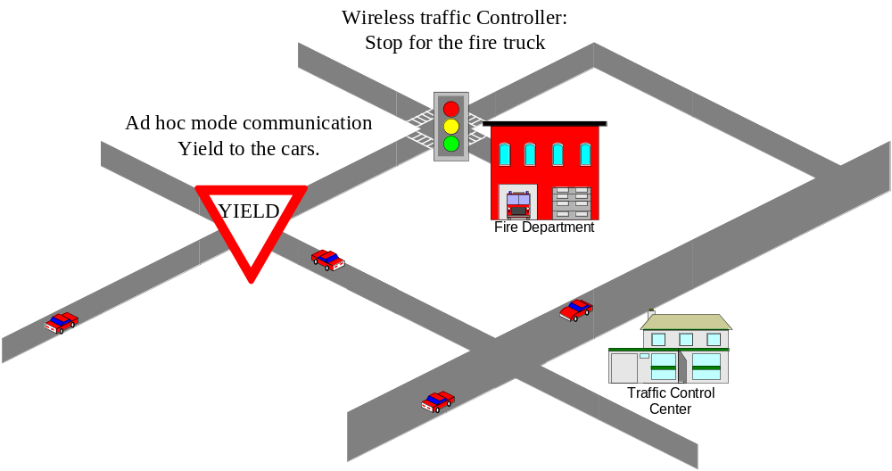
Intelligent Traffic Control

Slide 10
Grading
Labs: 70%
  You should participate every lab and know how it can be done.
Term Project: 30%
  Mid-term: Proposal due
  Final: Demo

